Slide 1
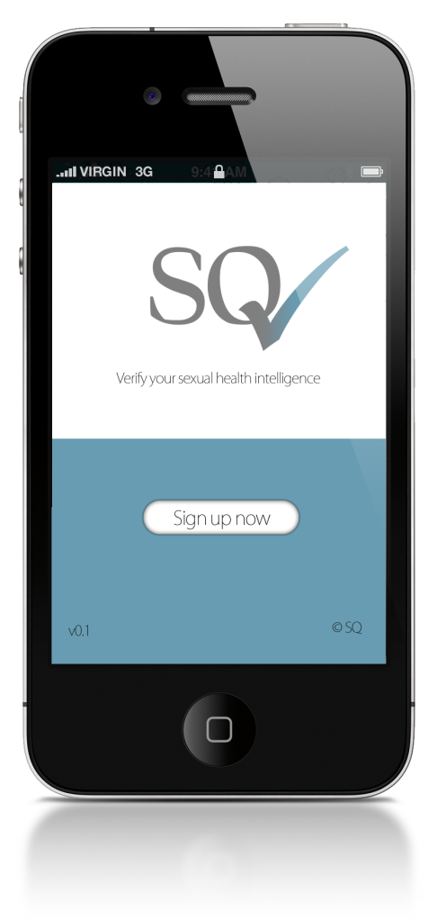
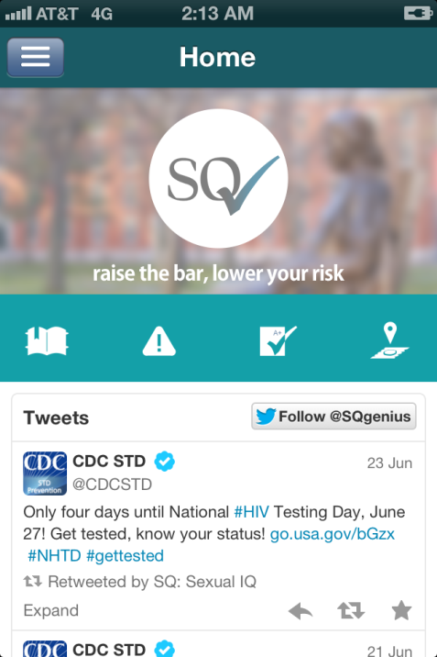
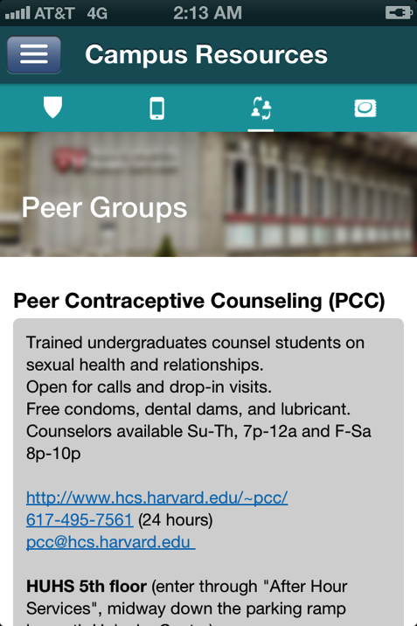
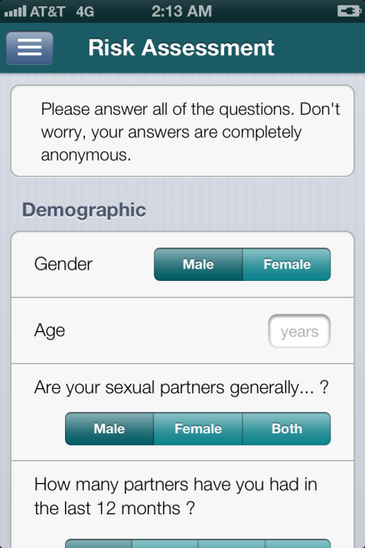
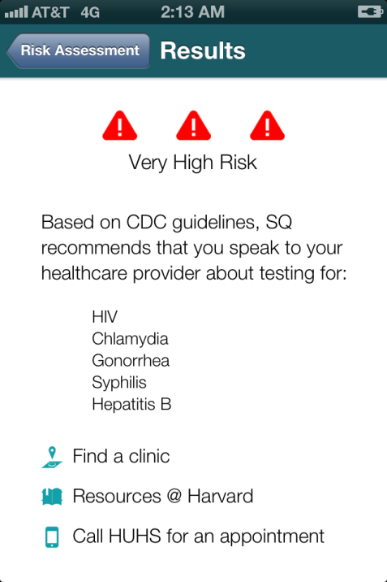
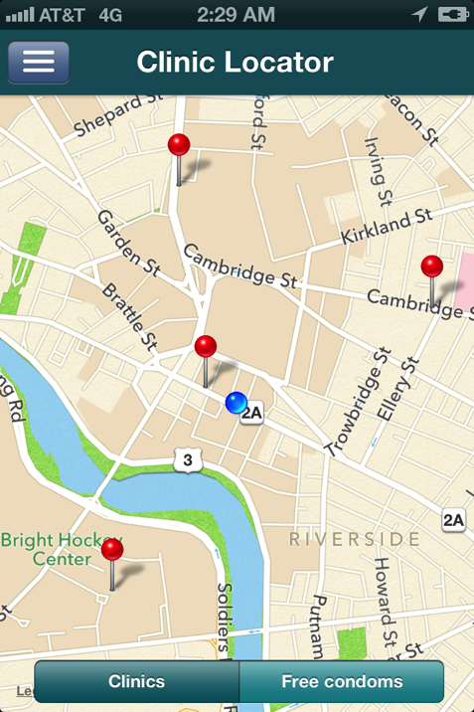
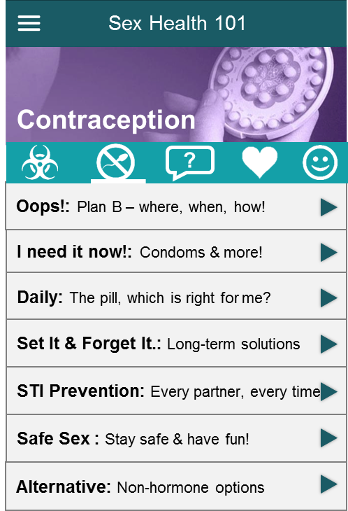


Peer Groups & Hotlines
Trained peer counselors are available for private and non-judgmental counseling on sexual health and relationship. Open for call and drop-in visits.
Free condom, dental dams, and lubricant.
Office hours: Su-Th, 7p-12a and F-Sa 8p-10p
Basement of Main College Buildling
Call: 1-800-764-0087
Resources on campus
Call for an appointment

Slide 2
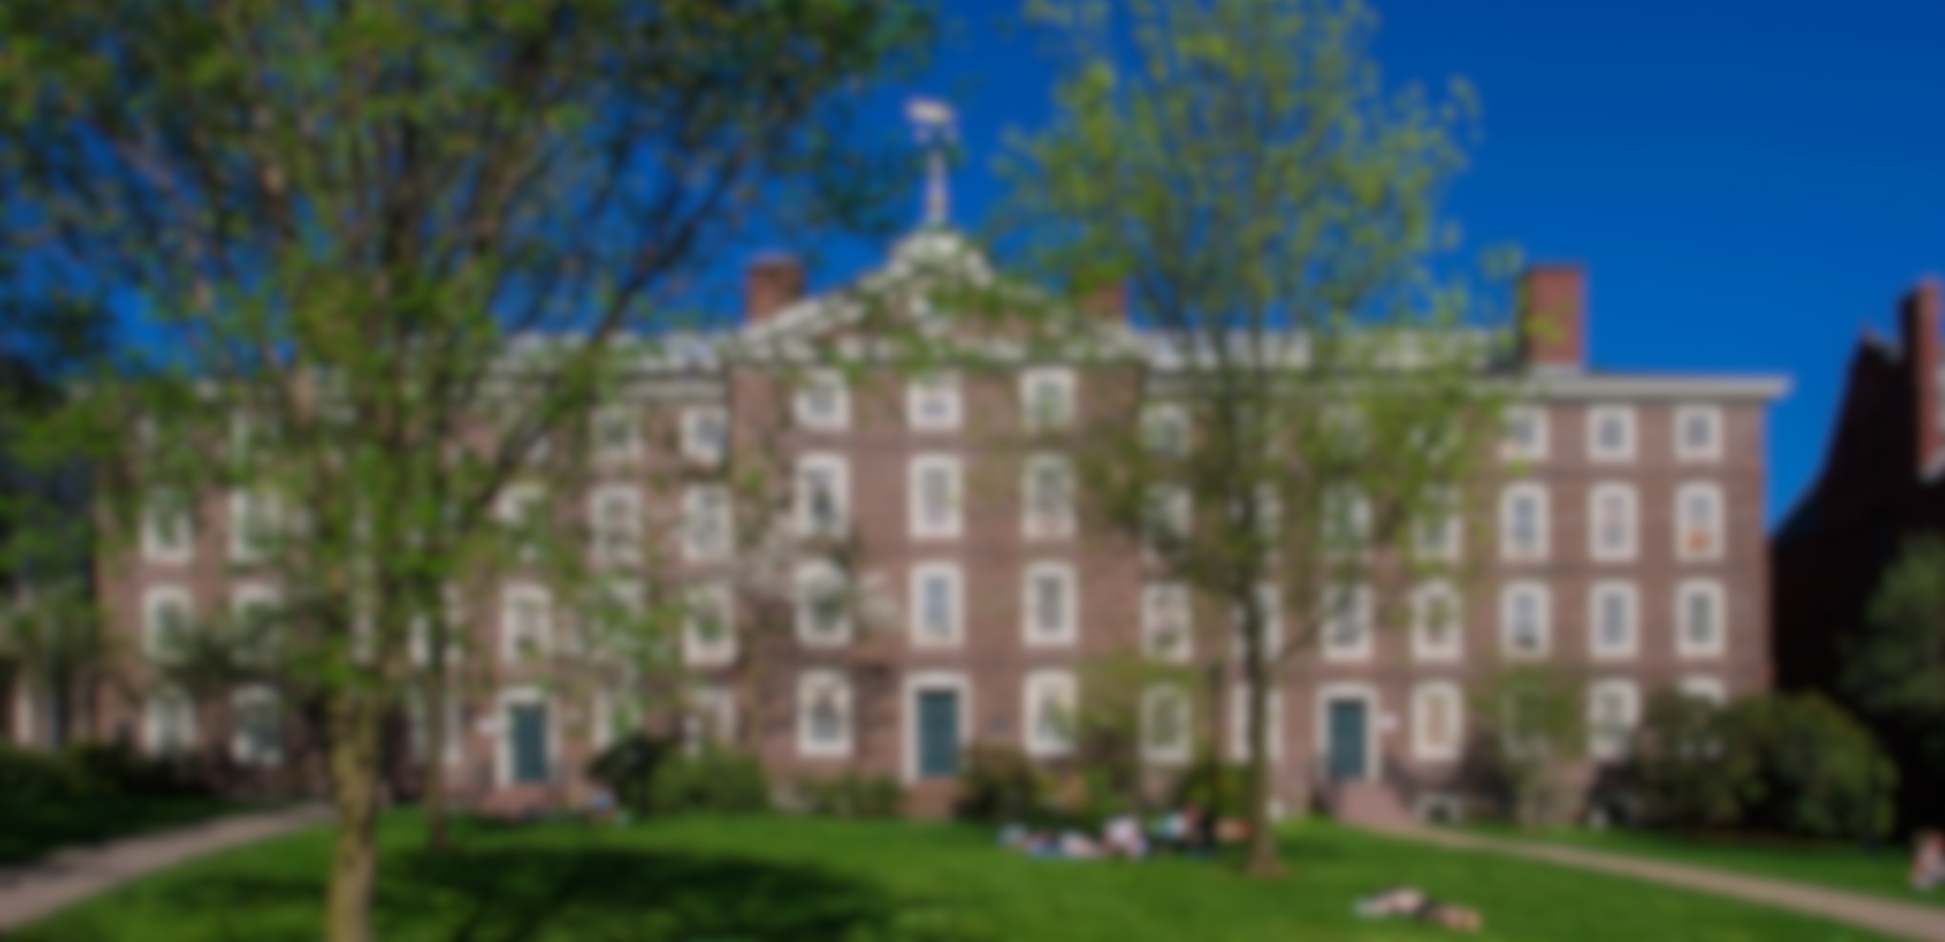

raise the bar, lower your risk

Slide 4

Notes:
3 messages:
75% sexually active
1/4 have std
prevent

Slide 5

75%
of college students are SEXUALLY ACTIVE

Slide 6

1in4
STI
will get an
by age 25

Slide 7

EDUCATE ENGAGE EMPOWER

Slide 8


